Slide 1

Marri Iacopo
Salamino Manuel
Salazar Molina Steven Alexander

Slide 2

Goals
User goals:
[G.1] Send notification about traffic violations.
[G.2] Add pictures, type of the violation, GPS and time to the violation report.
Authority goals:
[G.3] Check the correctness of a report.
[G.4] Generate traffic ticket from verified reports.
[G.5] Get suggestions about how to improve urban mobility.
Common goals:
[G.6] Access information about unsafe areas.
[G.7] Access statistics about effectiveness of SafeStreets.
[G.8] Access statistics about violations.

Slide 3
World and machine phenomena
World Phenomena
A person leaves the car in an inappropiate place.
A User witnesses a traffic violation.
Shared Phenomena
A User sends a report.
An Authority verifies a report.
SafeStreets shows details about a report.
SafeStreets shows safe/unsafe areas.
Machine Phenomena
SafeStreets computes statistics.
SafeStreets stores received reports.

Slide 4
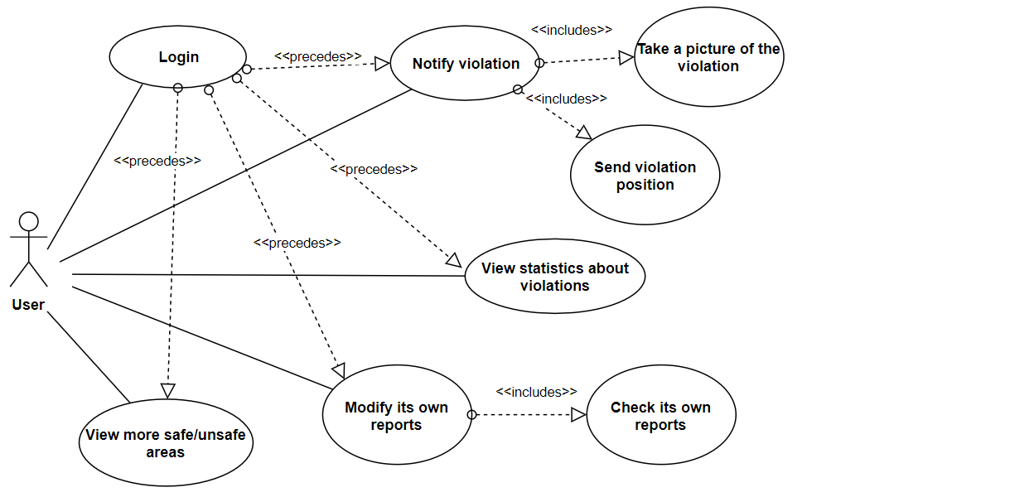
User Use case Diagram

Slide 5
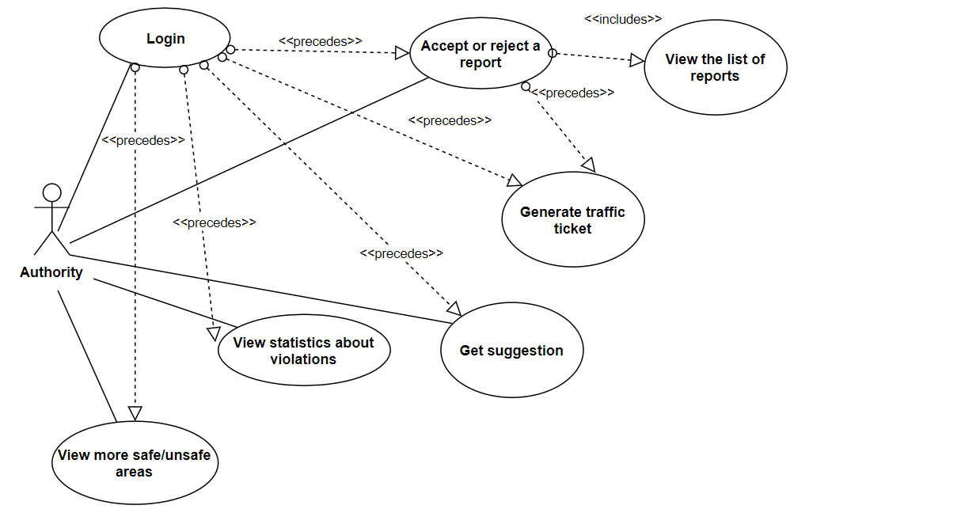
Authority Use case Diagram

Slide 6
[R.6] The System must compute the trustness of reports.
[R.20] The System must communicate with the Authority TrafficTicket Service in order to generate a traffic ticket.
[R.21] The System shall allow the User to send taken pictures by accessing the camera from the SafeStreets application.
[R.22] The System must keep its information about statistics up-to-date with all the reports it received.
[R.23] The System must generate suggestions based on the actual information and the actual urban situation.
REQUIREMENTS

Slide 7
[D.3] The GPS is assumed to be subject to a maximum error of 20meters.
[D.5] Information obtained by Municipality are supposed to be correct.
[D.7] Is assumed that the camera used by the User’s device is working properly.
[D.9] Is assumed that the municipality offers an API to access their urban mobility data.
ASSUMPTIONS

Slide 8
-- Report can't stay into different TrafficTicket --fact trafficTicketReport{ all r: Report |no disj tt1, tt2: TrafficTicket | r = tt1.report andr = tt2.report }
fact checkAuthorityZone{all tt: TrafficTicket |one r: Report |r = tt.report and tt.municipality =r.location.municipalityall tt: TrafficTicket |one a: Authority |tt in a.trafficTickets and a.municipality =tt.municipality}
ALLOY

Slide 9
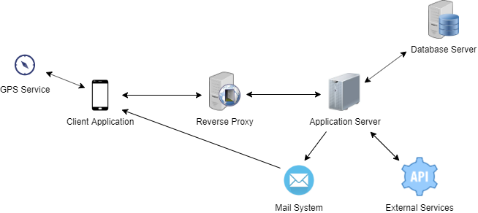
System overview

Slide 10
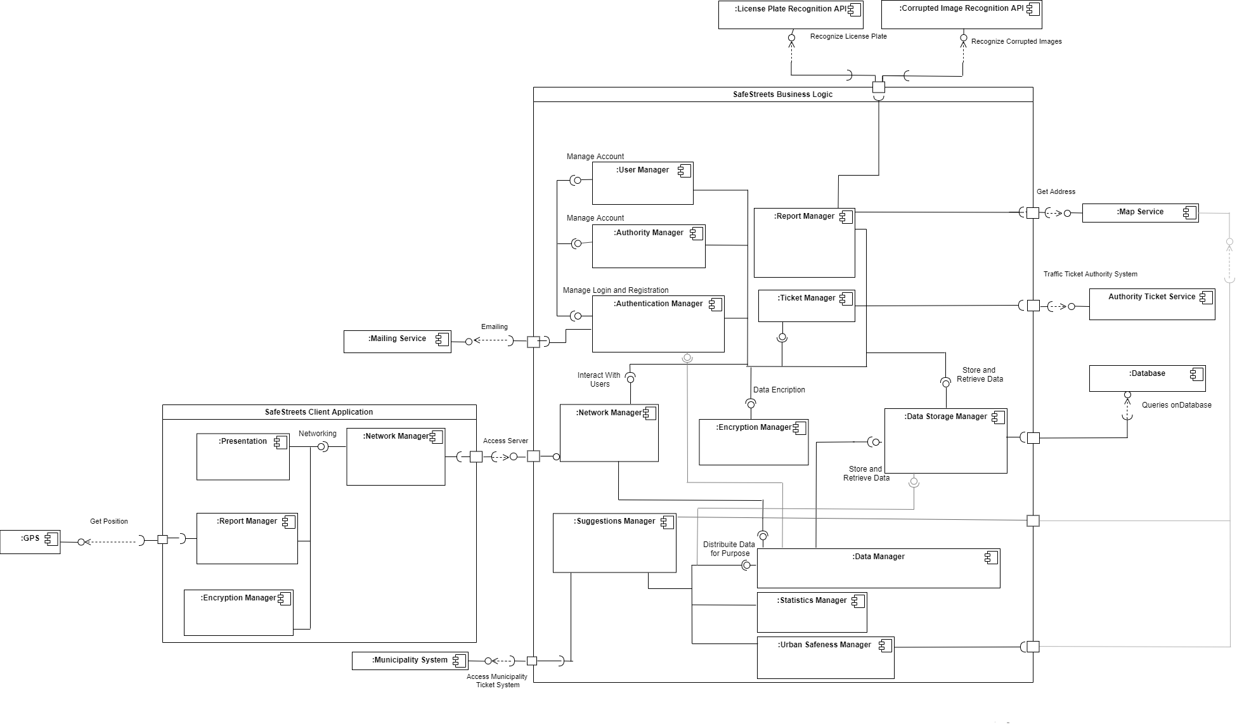
COMPonent diagram

Slide 11
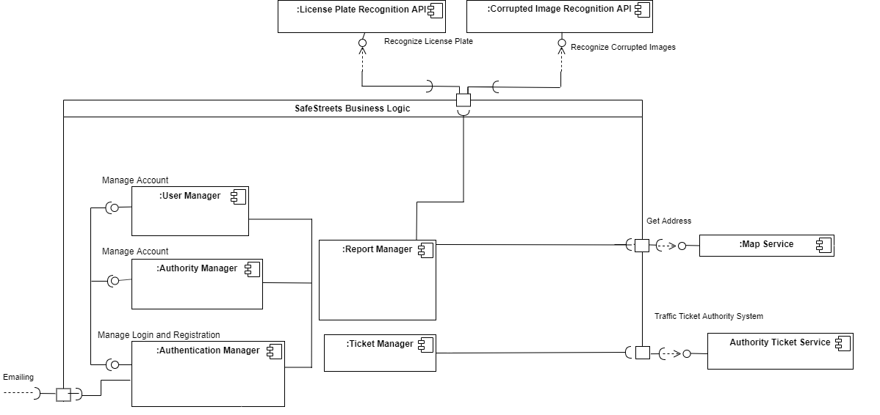
Meaningful interactions

Slide 12
Multi-Tier Architecture:
Guarantees that each tier only deals with a specific task, creating a flexible and reusable application.
REST:
Allows data exchange through HTTP protocol and stateless operations improving interoperability between systems.
RDBMS:
A Relational DBMS improves accuracy, flexibility, security and guarantee an easy management.
Observer:
Improves the scalability of the system, making easier to add new components or functionalities.
DESIGN CHOICES AND PATTERNS

